Slide 1
Understanding Data Structures in Python: Arrays, Lists, and Dictionaries
Fundamentals and practical uses for efficient programming

Slide 2

Session Agenda
Introduction to Data Structures in Python
Arrays and Lists: Foundations and Applications
Dictionaries: Key-Value Storage in Python
Practical Examples and Performance Considerations
Notes:
--- We will begin with an introduction to data structures in Python, then delve into arrays and lists, followed by dictionaries. Lastly, we will examine practical examples and performance considerations to help you choose the best data structure for your needs. Image source: Microsoft 365 content library

Slide 3
Introduction to Data Structures in Python

Slide 4

Definition and Significance of Data Structures
Organizing Data Efficiently
Data structures organize data to ensure quick access and easy modification in computing tasks.
Foundation for Algorithms
Effective algorithms rely on data structures to process and solve computational problems efficiently.
Solving Complex Problems
Data structures are essential tools in addressing complex computational challenges in various applications.
Notes:
--- Data structures organize and store data in a way that enables efficient access and modification. They form the backbone of effective algorithms and are essential for solving complex computational problems. Image source: Microsoft 365 content library

Slide 5
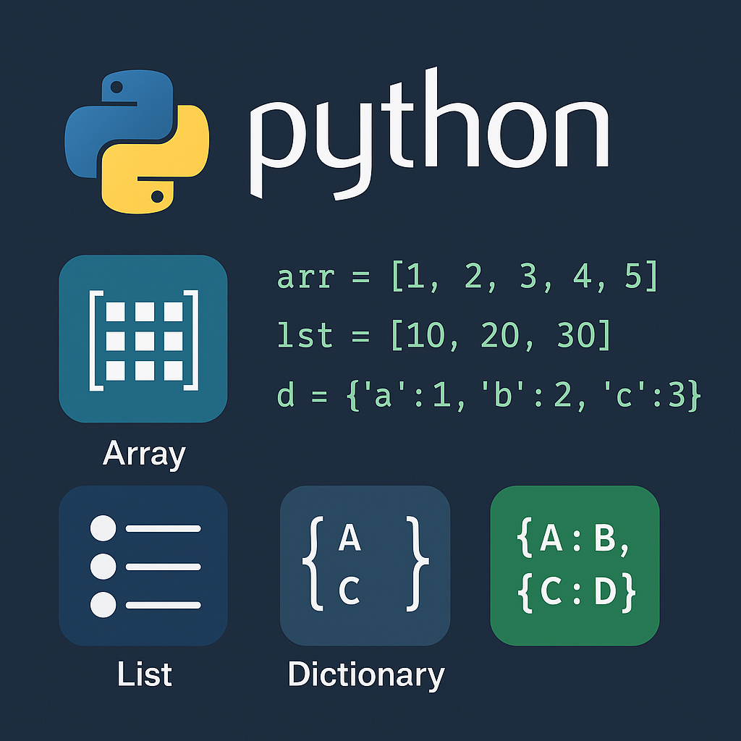
Overview of Built-In Python Data Structures
Lists
Lists are ordered, mutable collections ideal for storing sequences of items with flexible manipulation.
Tuples
Tuples are ordered, immutable collections used for fixed data sequences and ensuring data integrity.
Dictionaries
Dictionaries store key-value pairs enabling efficient data retrieval and mapping of unique keys to values.
Sets
Sets are unordered collections of unique elements useful for membership testing and eliminating duplicates.
Notes:
--- Python includes several built-in data structures such as lists, tuples, dictionaries, and sets. Each has unique properties suitable for various programming scenarios. Image source: Microsoft 365 content library

Slide 6
When and Why to Use Specific Data Structures
Data Type Considerations
Selecting data structures depends on the type of data being handled for efficient management.
Operation Requirements
Understanding required operations guides choosing the optimal data structure for tasks like searching or sorting.
Performance Optimization
Proper data structure choice enhances memory usage and execution speed, improving overall system performance.
Notes:
--- Choosing the right data structure depends on factors like data type, required operations, and performance needs. Understanding these helps optimize both memory usage and execution speed. Image source: Microsoft 365 content library

Slide 7
Arrays and Lists: Foundations and Applications

Slide 8

Distinguishing Between Arrays and Lists in Python
Flexibility of Python Lists
Python lists can store mixed data types and offer great flexibility for general programming tasks.
Efficiency of Arrays
Arrays, especially numpy arrays, provide memory-efficient storage optimized for numerical data processing.
Programming Implications
Understanding when to use lists or arrays is essential for writing effective and efficient Python code.
Notes:
--- While Python lists are flexible and can store mixed data types, arrays from the array module or numpy arrays are more memory-efficient and suited for numerical data. Understanding these distinctions is key to effective programming. Image source: Microsoft 365 content library

Slide 9

Creating and Manipulating Lists
List Creation
Lists are created using square brackets containing multiple elements separated by commas.
Modifying Lists
Lists can be modified by adding, removing, or changing elements dynamically at any position.
Dynamic Resizing
Lists support dynamic resizing, allowing flexible data handling and storage during program execution.
Notes:
--- Lists are created using square brackets and can be modified by adding, removing, or changing elements. They support dynamic resizing and are widely used for various data handling tasks. Image source: Microsoft 365 content library

Slide 10

Common Operations: Indexing, Slicing, and Iteration
Indexing Access
Indexing provides direct access to individual elements within a list using their position or index.
Slicing Sublists
Slicing extracts sublists by selecting a range of elements from the original list.
Iteration Process
Iteration processes each element in a list sequentially, enabling actions on all elements.
Notes:
--- Indexing allows access to individual elements, slicing extracts sublists, and iteration enables processing each element in a list. Mastering these operations is fundamental for working with lists. Image source: Microsoft 365 content library

Slide 11
Dictionaries: Key-Value Storage in Python

Slide 12
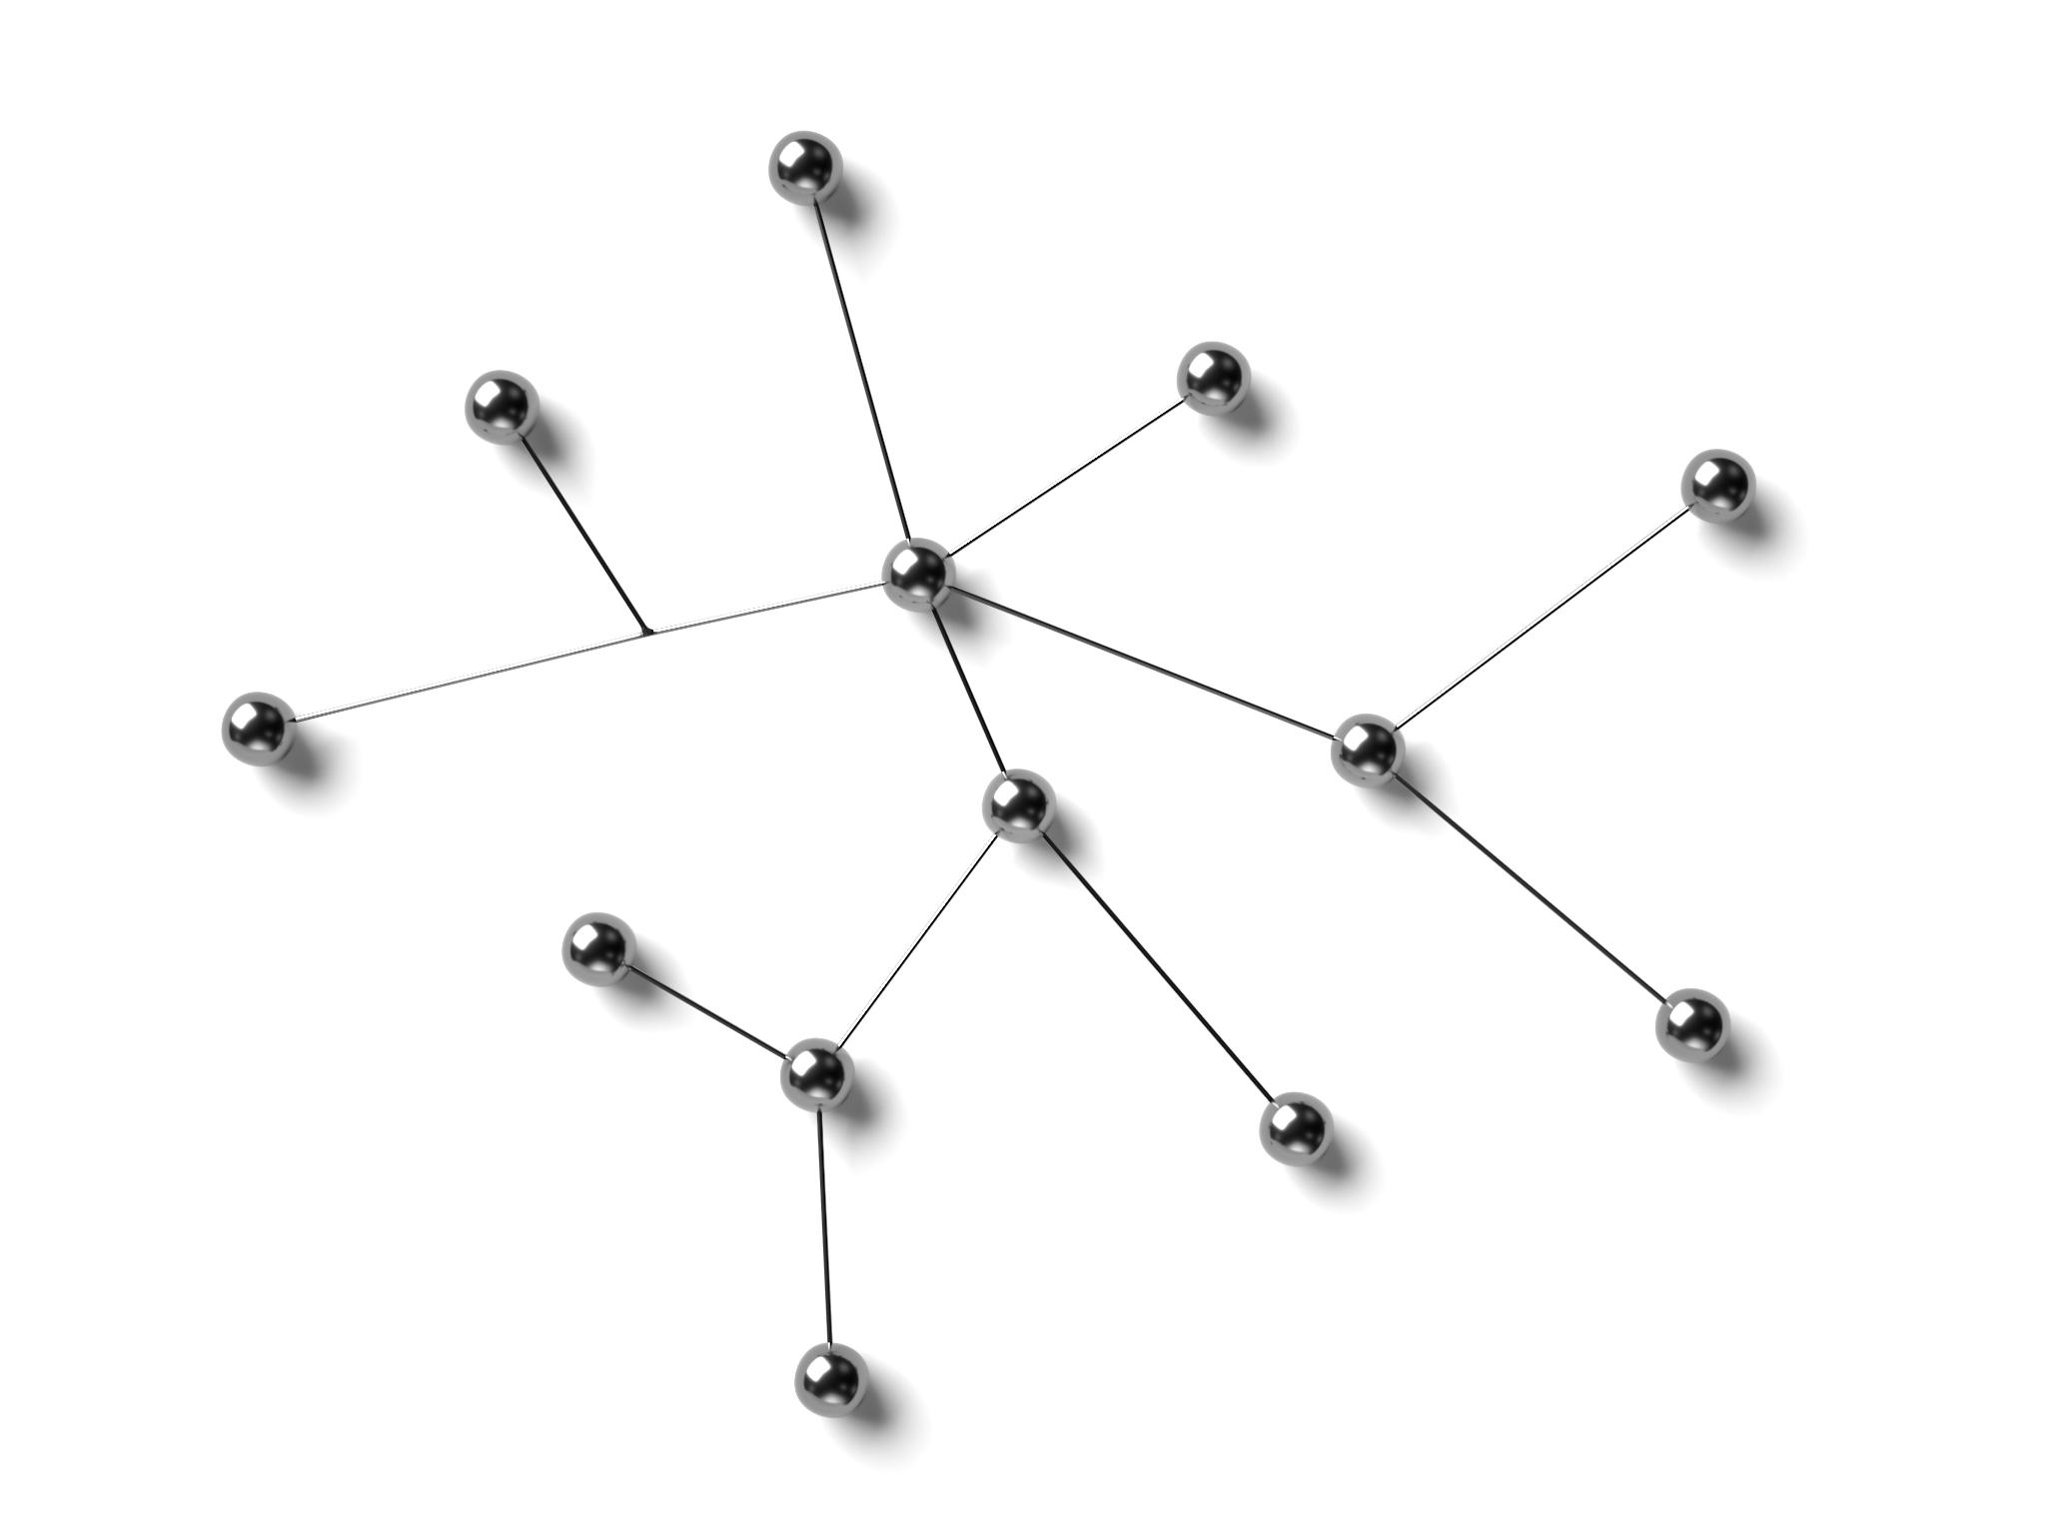
Introduction to Dictionaries and Their Use Cases
Key-based Data Access
Dictionaries use unique keys to access data efficiently without relying on position.
Ideal for Unique Identifiers
Dictionaries excel in managing datasets where each record has a distinct identifier.
Mapping Relationships
They are effective for mapping and representing complex relationships between data elements.
Notes:
--- Dictionaries provide an efficient way to organize and access data by keys rather than by position, making them ideal for datasets with unique identifiers or for mapping relationships. Image source: Microsoft 365 content library

Slide 13

Creating, Updating, and Accessing Dictionary Elements
Creating Dictionaries
Dictionaries are created using curly braces with key-value pairs for efficient data storage.
Updating Key-Value Pairs
Keys in dictionaries can be added or updated dynamically to modify stored data.
Accessing Values
Values are accessed using corresponding keys, crucial for data retrieval and manipulation.
Notes:
--- You can create dictionaries using curly braces, add or update key-value pairs dynamically, and access values using their corresponding keys, which is essential for data manipulation tasks. Image source: Microsoft 365 content library

Slide 14

Iterating and Common Dictionary Methods
Iterating Over Keys
Dictionaries allow iteration directly over keys, enabling efficient access to all dictionary entries.
Iterating Over Values
Using values() method, you can iterate through all dictionary values without keys.
Iterating Over Items
The items() method returns key-value pairs, supporting simultaneous iteration over both keys and values.
Notes:
--- Dictionaries support iteration over keys, values, or items. Common methods like keys(), values(), and items() facilitate efficient data processing and extraction. Image source: Microsoft 365 content library

Slide 15
Practical Examples and Performance Considerations

Slide 16

Selecting the Right Data Structure for a Problem
Data Nature Consideration
Selecting a data structure depends on the type and organization of the data involved in the problem.
Operation Requirements
The choice depends on operations needed such as searching, insertion, deletion, and traversal efficiency.
Efficiency and Trade-Offs
Understanding time and space trade-offs guides selection of optimized data structures for performance.
Notes:
--- Choosing the suitable data structure depends on the nature of data, operations needed, and efficiency requirements. Understanding trade-offs helps in writing optimized code. Image source: Microsoft 365 content library

Slide 17

Efficiency and Performance Comparison
Time Complexity Differences
Understanding time complexity helps choose data structures that optimize program speed for different operations.
Space Complexity Impact
Different data structures consume varying amounts of memory, affecting overall resource utilization.
Informed Decision Making
Knowing efficiency and performance aids programmers in selecting the best data structure for specific tasks.
Notes:
--- Different data structures offer varying performance characteristics in terms of time and space complexity. Knowing these helps in making informed decisions to improve program speed and resource use. Image source: Microsoft 365 content library

Slide 18

Real-World Examples and Best Practices
Effective Use of Arrays
Real projects showcase arrays for efficient data storage and sequential access.
Utilizing Lists
Lists provide flexible, dynamic collections ideal for various application needs.
Dictionaries for Mapping
Dictionaries enable quick lookup with key-value pairs improving code readability.
Adopting Best Practices
Following coding best practices ensures code is maintainable and scalable over time.
Notes:
--- Examples from real projects demonstrate effective use of arrays, lists, and dictionaries. Following best practices ensures maintainable and scalable code. Image source: Microsoft 365 content library

Slide 19
Conclusion
Efficient Data Handling
Mastering arrays, lists, and dictionaries enables efficient storage and manipulation of data in Python programs.
Writing Robust Programs
Understanding these data structures helps in writing more reliable and maintainable Python software solutions.
Proficient Python Development
Knowing the differences and uses of arrays, lists, and dictionaries is crucial for becoming a skilled Python developer.

